Slide 1
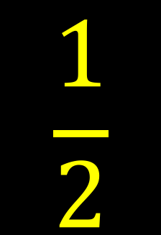

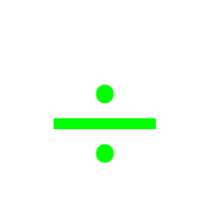


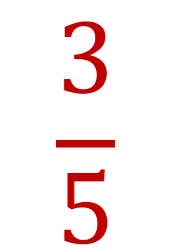

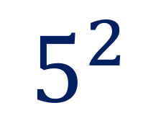
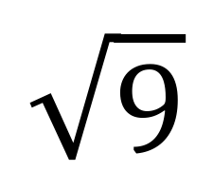
My Number Interactive Notebook
Name :
Class :
Teacher :
Term 3 Semester 2
1

Slide 2
Contents
Glossary or Formula Page
Page
Date
Description
2
3

Slide 3
Tasks
24
7
30
Essential Question
Questions
Notes
Summary
6
7

Slide 4
24
7
30
Date
Index Laws
EQ – Describe how the index laws can be used to simplify expressions with indices.
5

Slide 5
Task –Simplify the following
3⁴ x 3²
3⁷ ÷ 3⁴
(3²)⁴
(4x3)³
Hint: Remember your Index Laws from Term 1.

Slide 6
Index notation
We use index notation to show repeated multiplication by the same number.
For example:
We can use index notation to write 2 × 2 × 2 × 2 × 2 as:
index or power
2⁵
base
This number is read as ‘two to the power of five’.
2⁵ =
2 × 2 × 2 × 2 × 2 =
32
Notes:
Teacher notes
Talk about the use of index notation as a mathematical shorthand.

Slide 7
The first index law
When we multiply two numbers written in index form and with the same base we can see an interesting result.
For example:
3⁴ × 3² =
(3 × 3 × 3 × 3) × (3 × 3)
= 3 × 3 × 3 × 3 × 3 × 3
= 3⁶
= 3⁽⁴ ⁺ ²⁾
7³ × 7⁵ =
(7 × 7 × 7) × (7 × 7 × 7 × 7 × 7)
= 7 × 7 × 7 × 7 × 7 × 7 × 7 × 7
= 7⁸
= 7⁽³ ⁺ ⁵⁾
When we multiply two numbers with the same base the indices are added.
What do you notice?
Notes:
Teacher notes
Emphasize that the indices can only be added when the base is the same.

Slide 8
The second index law
When we divide two numbers written in index form and with the same base we can see another interesting result.
For example:
4 × 4 × 4 × 4 × 4
4⁵ ÷ 4² =
=
4 × 4 × 4 =
4³
= 4^{(5 – 2)}
4 × 4
5 × 5 × 5 × 5 × 5 × 5
5⁶ ÷ 5⁴ =
=
5 × 5 =
5²
= 5^{(6 – 4)}
5 × 5 × 5 × 5
When we divide two numbers with the same base the indices are subtracted.
What do you notice?
Notes:
Teacher notes
Emphasize that the indices can only be subtracted when the base is the same.

Slide 9
Zero indices
Look at the following division:
6⁴ ÷ 6⁴ =
1
Using the second index law:
6⁴ ÷ 6⁴ = 6^{(4 – 4)} =
6⁰
This means that:
6⁰ = 1
In fact, any number raised to the power of 0 is equal to 1.
For example:
10⁰ = 1
3.452⁰ = 1
723 538 592⁰ = 1

Slide 10
Negative indices
Look at the following division:
3 × 3
1
1
3² ÷ 3⁴ =
=
=
3 × 3 × 3 × 3
3 × 3
3²
Using the second index law:
3² ÷ 3⁴ = 3^{(2 – 4)} =
3^{–2}
That means that:
1
3^{–2} =
3²
1
1
1
Similarly:
6^{–1} =
7^{–4} =
and
5^{–3} =
6
7⁴
5³
Notes:
10
Teacher notes
Raising a number to the power of –1 is equivalent to finding its reciprocal.

Slide 11

Using algebra
We can write all of these results algebraically.
a^{m} × a^{n} = a^{(m + n)}
a^{m} ÷ a^{n} = a^{(m – n)}
a¹ = a
a⁰ = 1
1
a^{–1} =
a
1
a^{–n} =
a^{n}
Notes:
11
Teacher notes
Discuss the general form of each result where a is any number and m and n are integers.
Photo credit: © Shutterstock 2009, Flashon Studio

Slide 12
Now let’s try some Use your Task page to write the problem and your answer.

Slide 13
Index Laws
1
2
3
a^{m}xa^{n} = a^{m+n}
a^{m}÷a^{n} = a^{m-n}
(a^{m})^{n} = a^{mxn}
3⁹x3⁷ = 3¹⁶
2⁸x2³ = 2⁵
5⁷x5⁶ = 5¹³
2⁵x2³ = 2⁸
7⁶x7³ = 7⁹
3⁹÷3⁷ = 3²
2⁸÷2³ = 2⁵
5⁷÷5⁶ = 5
2⁵÷2³ = 2²
7⁶÷7³ = 7³
(3⁹)⁷ = 3⁶³
(2³)³ = 2⁹
(5⁷)⁶ = 5⁴²
(2⁵)³ = 2¹⁵
(7⁶)³ = 7¹⁸

Slide 14
Index Laws
4
5
a
b
^{n}
a^{n}
b^{n}
(ab)^{n} = a^{n} b^{n}
=
(2x3)⁷ = 2⁷x3⁷
(5x2)³ = 5³x2³
(9x5)⁶ = 9⁶x5⁶
(2x6)³ = 2³x6³
(3x7)³ = 3³x7³
=
=
=
2
3
4
2
3
4
4
3
11
2
2
3
11
2
12
13
5
12
13
5
5

Slide 15
Index Laws
6
7
a⁰ = 1
1
a^{n}
a^{-n} =
3⁰ = 1
52⁰ = 1
9⁰x5⁰ = 1
2x6⁰ = 2
3⁰x7 = 7
3 =
5 =
7 =
1
3
-4
4
-3
1
5
3
-6
1
7
6

